Slide 1
Advanced OLAP Optimization with Columnstore Indexes
Edward Pollack
Using Columnstore Architecture to Perfect OLAP Data Storage in SQL Server

Slide 2

Ed Pollack
Published author of Dynamic SQL: Applications, Performance, and Security.
Published author of Analytics Optimization with Columnstore Indexes in SQL Server
Published in Expert T-SQL Functions in SQL Server
Published author on SQLServerCentral, SQLShack, and SimpleTalk.
Data Architect @ Datto
Organizer of SQL Saturday Albany & New Jersey
Speaker at many data events Twitter: @EdwardPollack

Slide 3
Agenda
Brisk review of columnstore indexes and storage.
Columnstore compression
Writing to columnstore indexes
Reading from columnstore indexes
How to make your OLAP workloads FAST
Take a deep breath!
Note: This presentation uses SQL Server 2019!

Slide 4

The Challenge (Review)
Rowstore is built for transactional workloads. Rows are stored sequentially on pages to minimize reads.

Slide 5
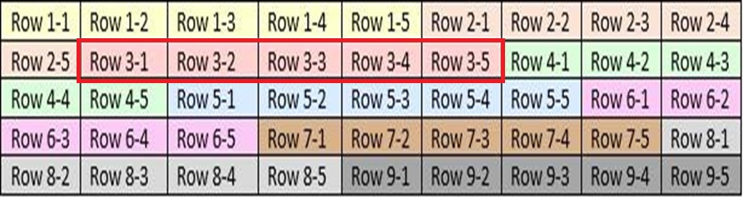
The Challenge (Review)
Reading a single sales order (row 3) is straightforward:

Slide 6

The Challenge (Review)
Summing a single column (col 2) over many rows is painful:

Slide 7
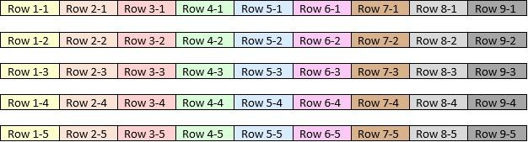
The Challenge (Review)
Columnstore organizes data by columns into segments. Each segment is a discrete storage structure.

Slide 8
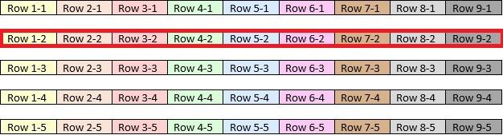
The Challenge (Review)
Getting a sum for a single column requires reading only the data for that one column (segment). This is intended for OLAP data!

Slide 9
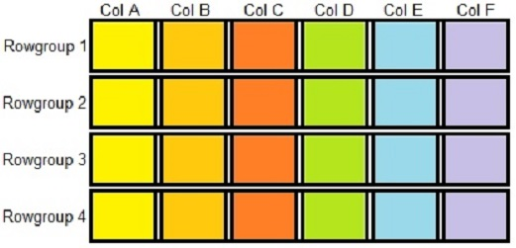
Columnstore Index Architecture (Review)
Data is organized into rowgroups, up to 2²⁰ rows per rowgroup
(that’s 1,048,576 for those keeping count at home)
Data for each column in each rowgroup is stored in segments.
Total segments = rowgroups * columns
Columnstore metadata is stored centrally for all rowgroups/segments.

Slide 10

Columnstore Index Architecture (Review)
Rowgroup & segment elimination control volume of data read from storage into memory
Query less columns
Filter on ordered data

Slide 11
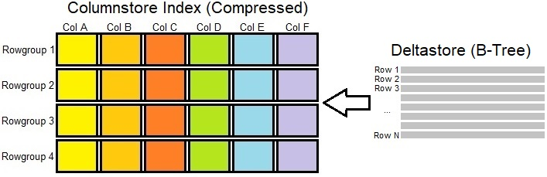
Columnstore Index Architecture (Review)
Compressing columnstore data is expensive. The delta store accumulates smaller batches
of insert operations and processes them in bulk asynchronously. Queries
read both compressed segments and the delta store to retrieve result sets.

Slide 12
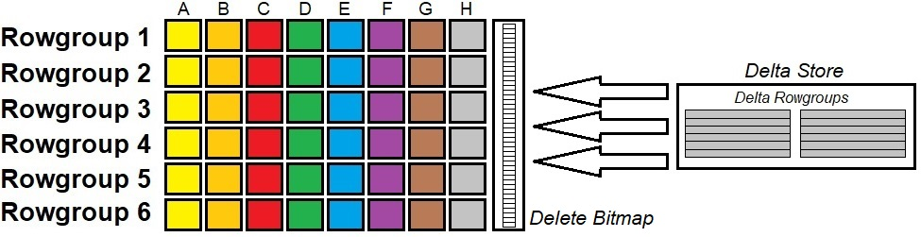
Columnstore Index Architecture (Review)
When is a delete not a delete? Columnstore indexes soft-delete using the Delete Bitmap.
Delete bitmaps are only created when deleted rows exist and indicates which rows in each rowgroup are deleted.
Rows flagged as deleted are ignored when processes read them.

Slide 13
Review Complete!
(Deep breath!)

Slide 14
Columnstore Compression
Segments are each compressed separately(!!!)
1 segment = 1 column = 1 data type.
Data of one data type compresses effectively.
Data in close proximity to other data (by a date/time dimension) compresses even more effectively.

Slide 15
Step #1: Encoding
Transform how data is stored to use less storage per value.
Most common encoding methods:
Dictionary encoding
Value encoding
These are lossless algorithms that require minimal computing resources to reduce data footprint.
DMVs tell us how encoding algorithms are applied:
sys.column_store_segments (links to dictionaries, value parameters)
sys.column_store_dictionaries (dictionary detail)

Slide 16
Dictionary Encoding
A dictionary is a compressed hash table of reusable values.
Limited to 16MB in size! When 16MB is neared, a rowgroup will be split alongside its dictionary. High cardinality and wide columns can lead to undersized rowgroups. Normalizing can help!
Numeric columns can use dictionary encoding, but prefer to be value encoded when they have high cardinality.
Only used by compressed rowgroups, not delta rowgroups.
Global dictionaries can be used across multiple rowgroups. Local dictionaries are used for a single rowgroup*
* Occasionally, a local dictionary may be used for an additional rowgroup that is compressed via the same process as the first rowgroup.

Slide 17
Dictionary Encoding Example
Original Data
Values | Size (bytes)
Chocolate Chip Cookie | 21
Blueberry Scone | 15
Double-Chocolate Brownie | 24
Strawberry Cake | 15
Baklava | 7
Double-Chocolate Brownie | 24
Double-Chocolate Brownie | 24
Baklava | 7
Double-Chocolate Brownie | 24
Chocolate Chip Cookie | 21
Chocolate Chip Cookie | 21
TOTAL DATA SIZE (bytes): | 203

Slide 18
Dictionary Encoding Example
Original Data
Values | Size (bytes)
Chocolate Chip Cookie | 21
Blueberry Scone | 15
Double-Chocolate Brownie | 24
Strawberry Cake | 15
Baklava | 7
Double-Chocolate Brownie | 24
Double-Chocolate Brownie | 24
Baklava | 7
Double-Chocolate Brownie | 24
Chocolate Chip Cookie | 21
Chocolate Chip Cookie | 21
TOTAL DATA SIZE (bytes): | 203
Dictionary
Index ID | String Value | Size (bytes)
0 | Chocolate Chip Cookie | 21
1 | Blueberry Scone | 15
2 | Double-Chocolate Brownie | 24
3 | Strawberry Cake | 15
4 | Baklava | 7
 | TOTAL DICTIONARY SIZE (bytes): | 82

Slide 19
Dictionary Encoding Example
Original Data
Values | Size (bytes)
Chocolate Chip Cookie | 21
Blueberry Scone | 15
Double-Chocolate Brownie | 24
Strawberry Cake | 15
Baklava | 7
Double-Chocolate Brownie | 24
Double-Chocolate Brownie | 24
Baklava | 7
Double-Chocolate Brownie | 24
Chocolate Chip Cookie | 21
Chocolate Chip Cookie | 21
TOTAL DATA SIZE (bytes): | 203
Dictionary Encoded Data
Index ID | Size (bits)
0 | 3
1 | 3
2 | 3
3 | 3
4 | 3
2 | 3
2 | 3
4 | 3
2 | 3
0 | 3
0 | 3
TOTAL DATA SIZE (bits): | 33
Dictionary
Index ID | String Value | Size (bytes)
0 | Chocolate Chip Cookie | 21
1 | Blueberry Scone | 15
2 | Double-Chocolate Brownie | 24
3 | Strawberry Cake | 15
4 | Baklava | 7
 | TOTAL DICTIONARY SIZE (bytes): | 82

Slide 20
Demo: Dictionary Encoding

Slide 21
Value Encoding
Mathematical manipulation to shrink storage footprint of numeric columns.
Values are transformed using common rules across a segment.
A segment may be subject to both dictionary and value encoding.
Can be applied to dates as well.

Slide 22
Value Encoding Example (Generic Numeric)
Value | Min Size in bits
65000 | 16
10000 | 14
950000 | 20
100 | 8
30 | 6
90 | 8
120 | 8
8000 | 14
9580 | 14
 | 108
Value | Value * 10⁻¹ | Min Size in bits
65000 | 6500 | 14
10000 | 1000 | 10
950000 | 95000 | 18
100 | 10 | 4
30 | 3 | 2
90 | 9 | 4
120 | 12 | 4
8000 | 800 | 10
9580 | 958 | 10
 |  | 76
Pick a common divisor (magnitude)
Divide values by the common divisor

Slide 23
Value Encoding Example (Generic Numeric)
Value | Min Size in bits
65000 | 16
10000 | 14
950000 | 20
100 | 8
30 | 6
90 | 8
120 | 8
8000 | 14
9580 | 14
 | 108
Value | Value - 30 | Min Size in bits
65000 | 64970 | 16
10000 | 9970 | 14
950000 | 949970 | 20
100 | 70 | 8
30 | 0 | 1
90 | 60 | 6
120 | 90 | 8
8000 | 7970 | 14
9580 | 9550 | 14
 |  | 101
Pick a common base
Subtract the common base from
each value

Slide 24
Value Encoding Example (Chunky Identity Column)
Value | Min Size in bits
1500000000 | 32
1500000001 | 32
1500000002 | 32
1500000003 | 32
1500000004 | 32
1500000005 | 32
1500000006 | 32
1500000007 | 32
1500000008 | 32
1500000009 | 32
 | 320
Value | Value - 1500000000 | Min Size in bits
1500000000 | 0 | 1
1500000001 | 1 | 1
1500000002 | 2 | 2
1500000003 | 3 | 2
1500000004 | 4 | 1
1500000005 | 5 | 4
1500000006 | 6 | 4
1500000007 | 7 | 4
1500000008 | 8 | 4
1500000009 | 9 | 4
 |  | 46
Pick a common base
Subtract the common base from
each value

Slide 25
Demo: Value Encoding

Slide 26
Step #2: Optimization
Row order within a rowgroup does not matter!
Optimization reorders rows within a rowgroup.
This is computationally expensive.
Vertipaq Optimization is what SQL Server uses for this process.
Can greatly improve compression ratio by grouping like values together.

Slide 27
Optimization Example
Optimization does not save space, but sets up data
so that compression is far more effective later.
Dictionary Encoded Data
Index ID | Size (bits)
0 | 3
1 | 3
2 | 3
3 | 3
4 | 3
2 | 3
2 | 3
4 | 3
2 | 3
0 | 3
0 | 3
TOTAL DATA SIZE (bits): | 33
Optimized Data
Index ID | Size (bits)
0 | 3
0 | 3
0 | 3
1 | 3
2 | 3
2 | 3
2 | 3
2 | 3
3 | 3
4 | 3
4 | 3
TOTAL DATA SIZE (bits): | 33

Slide 28
Demo: Vertipaq Optimization

Slide 29
Optimization Exceptions
There are 2 scenarios where Vertipaq Optimization is not used:
Data merged from a delta rowgroup into a clustered columnstore index that has at least one non-clustered rowstore index.
Columnstore indexes on memory-optimized tables.
Optimized rowgroups remain optimized when non-clustered rowstore indexes are added.
Therefore, careful planning can ensure optimal compression, even with supporting rowstore indexes.

Slide 30
Step #3: Compression
After encoding and optimization, data is compressed using traditional algorithms focused on repeating byte patterns.
SQL Server uses the Microsoft xVelocity algorithm for Columnstore compression
SQL Server uses the Microsoft Xpress algorithm for Columnstore archive compression.
Both columnstore compression algorithms use at least bit-packing and run-length encoding. Other algorithms are used situationally.

Slide 31
Bit-Packing
Unneeded bits are shaved off of larger data types.
Value | SQL Data Type | Size (bits) | Bit-Packed Size
65000 | INT | 32 | 16
10000 | INT | 32 | 14
950000 | INT | 32 | 20
100 | INT | 32 | 8
30 | INT | 32 | 6
90 | INT | 32 | 8
120 | INT | 32 | 8
8000 | INT | 32 | 14
9580 | INT | 32 | 14
 |  | 288 | 108

Slide 32
Run-Length Encoding
Repeating data patterns are simplified. Vertipaq optimization greatly improved the efficiency of run-length encoding.
Dictionary Encoded Data | Vertipaq Optimization | Run-Length Encoding
2 | 0 | 0 (1)
1 | 1 | 1 (2)
0 | 1 | 2 (3)
2 | 2 | 3 (3)
1 | 2 | 4 (1)
2 | 2
3 | 3
4 | 3
3 | 3
3 | 4

Slide 33
Bulk-Inserting Data Into a Columnstore Index (aka: Writing Data FAST)
Inserts of 102,400 rows or more into a columnstore index will use a minimally logged bulk-insert process.
Unlike other minimally-logged processes, this is automatic.
Less than 102,400 always uses the delta store.
102,400 rows or more in one INSERT will:
Split rows into rowgroups (2²⁰ rows each).
Remainder is bulk-inserted (if 102,400 rows or more) or inserted into the delta store (if less than 102,400 rows)
UPDATE does not bulk insert.

Slide 34
Demo: Bulk-Inserting Data Into a Columnstore Index

Slide 35
Insert Guidance
Consolidate trickle inserts into staged inserts with larger batches.
If read performance is acceptable, leave delta rowgroups alone.
If read performance is slow, consider regular REORG operations to force delta rowgroups into compressed rowgroups.

Slide 36
Delete/Update Guidance
Avoid UPDATE operations. They do not bulk insert and are very slow. Replace with DELETE/INSERT if needed. But beware data order. Columnstore is OLAP, but still adheres to ACID.
Beware tables that migrate from rowstore to columnstore!
Deletes are soft-deletes.
REORG can merge undersized rowgroups together. Cannot do so with dictionary pressure.
REORG can self-merge and remove deleted rows (when there are > 102,400).
REORG operations greatly help write-heavy tables.

Slide 37
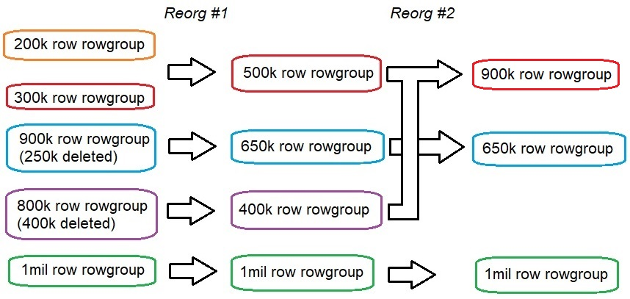
Merge & Self-Merge

Slide 38
Segment Elimination
Columns not selected = segments skipped.
Select only columns needed.
Beware unneeded where, group by, order by, having, etc…

Slide 39
Rowgroup Elimination
Columnstore indexes are not ordered by default!
Columnstore metadata is used to reduce segment reads.
Min/max values for each column are tracked per segment.
Ordered data allows for irrelevant segments to be skipped.
Order by column(s) that are most often filtered on.
A time dimension is often the ideal choice
Bonus: Ordered data saves on storage!
This is the #1 key to performance in a large columnstore index!

Slide 40
Demo: Rowgroup Elimination

Slide 41
Ordered Clustered Columnstore Index
SQL Server 2022+ only.
Can define column order on a columnstore index.
Does not apply to pre-existing rowgroups.
Is an offline operation for affected partitions.
Uses TempDB to sort data. Ensure adequate TempDB space.
Ordering data via data load processes is preferable.

Slide 42
Partitioning
Each partition contains (essentially) its own isolated columnstore index structure.
Partition column (usually) is the same as the ordering column.
Partition elimination & rowgroup elimination are good friends.
Ensure each partition is large enough to support full rowgroups.
Allows for easier maintenance:
Partition swapping
Partition truncation
Index maintenance by partition
Different columnstore compression per partition.

Slide 43
Columnstore Guidance: General
Columnstore index: At least millions of rows. The more the merrier.
Partitioning: At least millions of rows per partition.
Archive compression: Data that is (mostly) read-only and not often used. Can be applied by partition.

Slide 44
Columnstore Guidance: Variations
Non-clustered rowstore: Only when a secondary dimension is critical to analytics. Consider a second columnstore index ordered by that dimension! Test thoroughly.
Non-clustered columnstore: Better with tables that are more read/less write – few updates. Real-time operational analytics sound great, but are expensive to maintain. Restrict column list as much as possible. Test thoroughly.
Memory-Optimized: Avoid unless unique/niche use-case arise. Memory-optimized tables are built for OLTP scenarios.

Slide 45
Conclusion
Columnstore indexes can be optimized to save significant space and return exceptional performance.
The internal details of columnstore indexes are key to this.
Well-maintained columnstore indexes are almost set-and-forget. But exceptions eventually destroy that assumption. Beware one-time-maintenance, updates, deletes, unordered inserts, etc…
Each new version of SQL Server improves this feature!
When used correctly, columnstore indexes can scale indefinitely.

Slide 46
Questions!?
Edward Pollack
@EdwardPollack
ed@edwardpollack.com

